Slide 1

50.039 Theory and Practice of Deep Learning W6-S2 Times Series Data and Recurrent Neural Networks
Matthieu De Mari

Slide 2
About this week (Week 6)
What is a time series dataset?
How to analyze a time series, and what are typical deep learning models capable of doing that?
What is history, and why is it needed for time series predictions?
What is a good history length?
What is memory and how to represent it in a Neural Network model?
How to implement a first vanilla Recurrent Neural Network model?
Why is the vanishing gradient problem prominent in RNNs?

Slide 3
About this week (Week 6)
What is the LSTM model?
What is the GRU model?
What are one-to-one, one-to-many, many-to-one and many-to-many models?
What are some typical application examples of these?
What is a Seq2Seq model?
What are encoder and decoder architectures?
What is an autoregressive RNN?

Slide 4
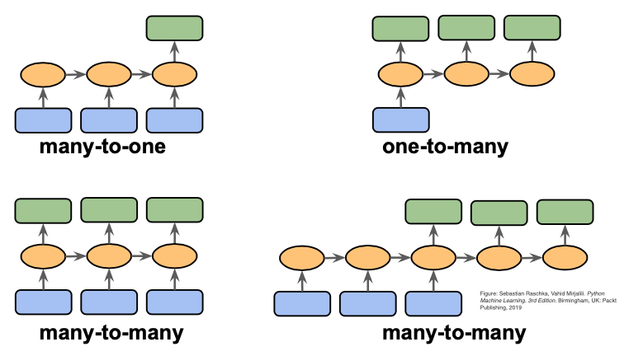
A quick word on one/many-to-one/many models

Slide 5
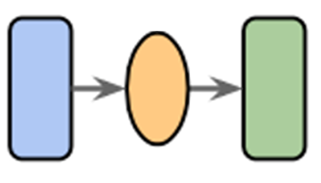
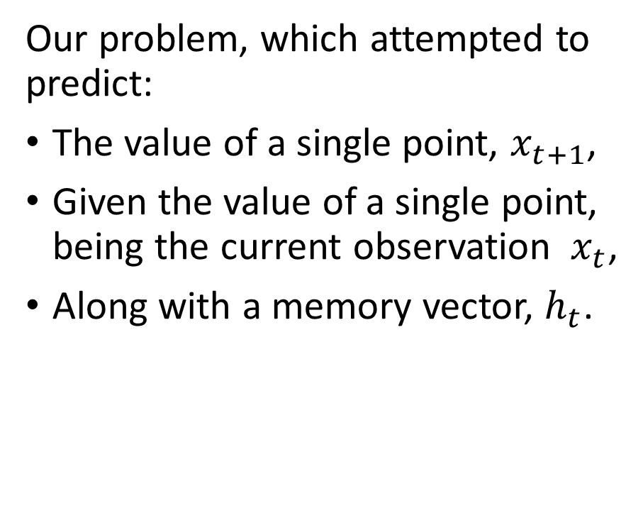
One-to-one models
Definition (one-to-one models):
A one-to-one model is a machine learning model that:
Takes a single input,
And, optionally, a memory vector,
And attempts to produce a single output.
This can be seen as the simplest type of machine learning problem.
Our problem, which attempted to predict:
The value of a single point, $x_{t+1}$,
Given the value of a single point, being the current observation $x_{t}$,
Along with a memory vector, $h_{t}$.

Slide 6
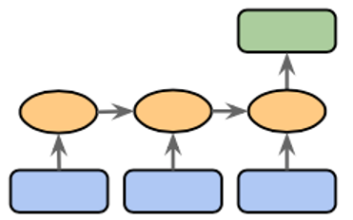
Many-to-one models
Definition (many-to-one models):
A many-to-one model is a machine learning model that:
Takes many inputs (in sequence or not),
And, optionally, a memory vector,
And attempts to produce a single output.
This is another common type of ML problem we have seen so far.

Slide 7
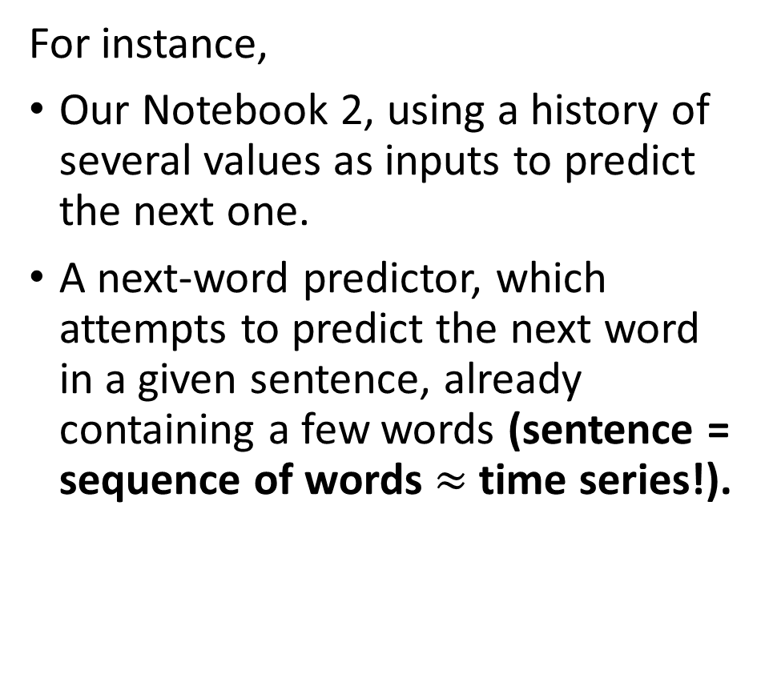
Many-to-one models
Definition (many-to-one models):
A many-to-one model is a machine learning model that:
Takes many inputs (in sequence or not),
And, optionally, a memory vector,
And attempts to produce a single output.
This is another common type of ML problem we have seen so far.
For instance,
Our Notebook 2, using a history of several values as inputs to predict the next one.
A next-word predictor, which attempts to predict the next word in a given sentence, already containing a few words (sentence = sequence of words $≈$ time series!).

Slide 8
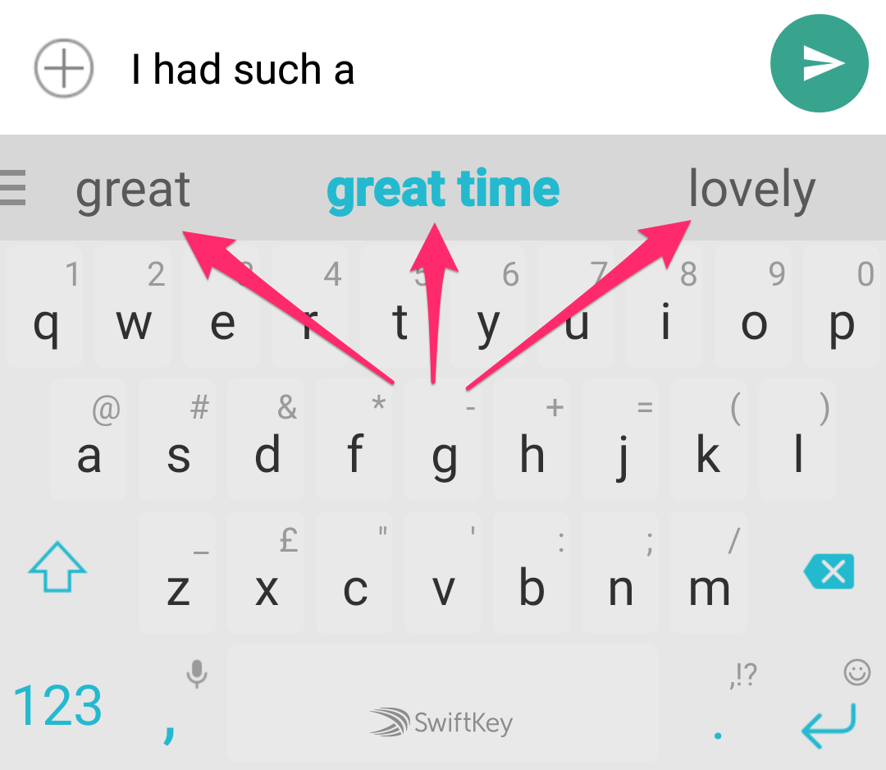

Many-to-one models
Definition (many-to-one models):
A many-to-one model is a machine learning model that:
Takes many inputs (in sequence or not),
And, optionally, a memory vector,
And attempts to produce a single output.
This is another common type of ML problem we have seen so far.
For instance,
Our apartment predictor, with multiple features describing the apartments.
Our Notebook 2, using a history of several values as inputs to predict the next one.
A next-word predictor, which attempts to predict the next word in a given sentence (sentence = sequence of words $≈$ time series!).

Slide 9
Many-to-one models
Definition (many-to-one models):
A many-to-one model is a machine learning model that:
Takes many inputs (in sequence or not),
And, optionally, a memory vector,
And attempts to produce a single output.
This is another common type of ML problem we have seen so far.
It would be possible to use a RNN of some sort for these problems, and only keep the final output (discarding all other calculated in the process), to compute a loss function of some sort.

Slide 10
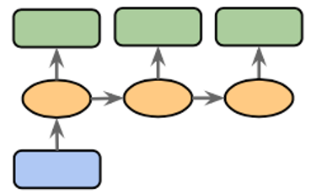
One-to-many models
Definition (one-to-many models):
A one-to-many model is…
You get what it means now.
To be honest, very few problems fall in the category of one-to-many, because most of the time we prefer to have a higher dimensionality on inputs than outputs…

Slide 11
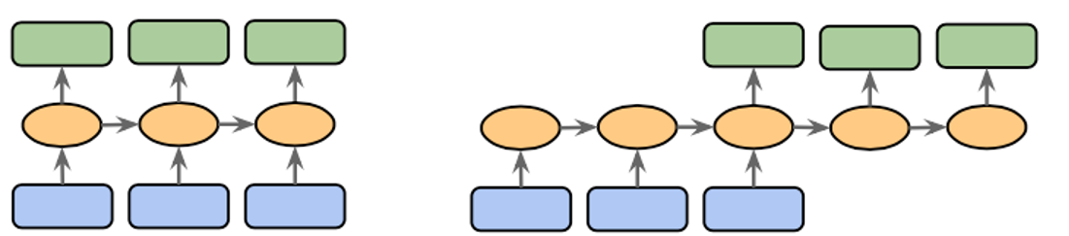
Many-to-many/Sequence-to-sequence models
Definition (many-to-many models):
A many-to-many (or Seq2Seq) model is a machine learning model that:
Takes many inputs (in sequence or not),
And, optionally, a memory vector,
And attempts to produce many outputs.
This is also a very common type of ML problems, which we will investigate more on the coming weeks.

Slide 12
Many-to-many/Sequence-to-sequence models
Definition (many-to-many models):
A many-to-many (or Seq2Seq) model is a machine learning model that:
Takes many inputs (in sequence or not),
And, optionally, a memory vector,
And attempts to produce many outputs.
This is also a very common type of ML problems, which we will investigate more on the coming weeks.
For instance,
A stock market predictor that takes several points as inputs (history) and attempts to predict the next few values of the stock prices instead of just the next one.
A translation model that translates text from English to French.

Slide 13
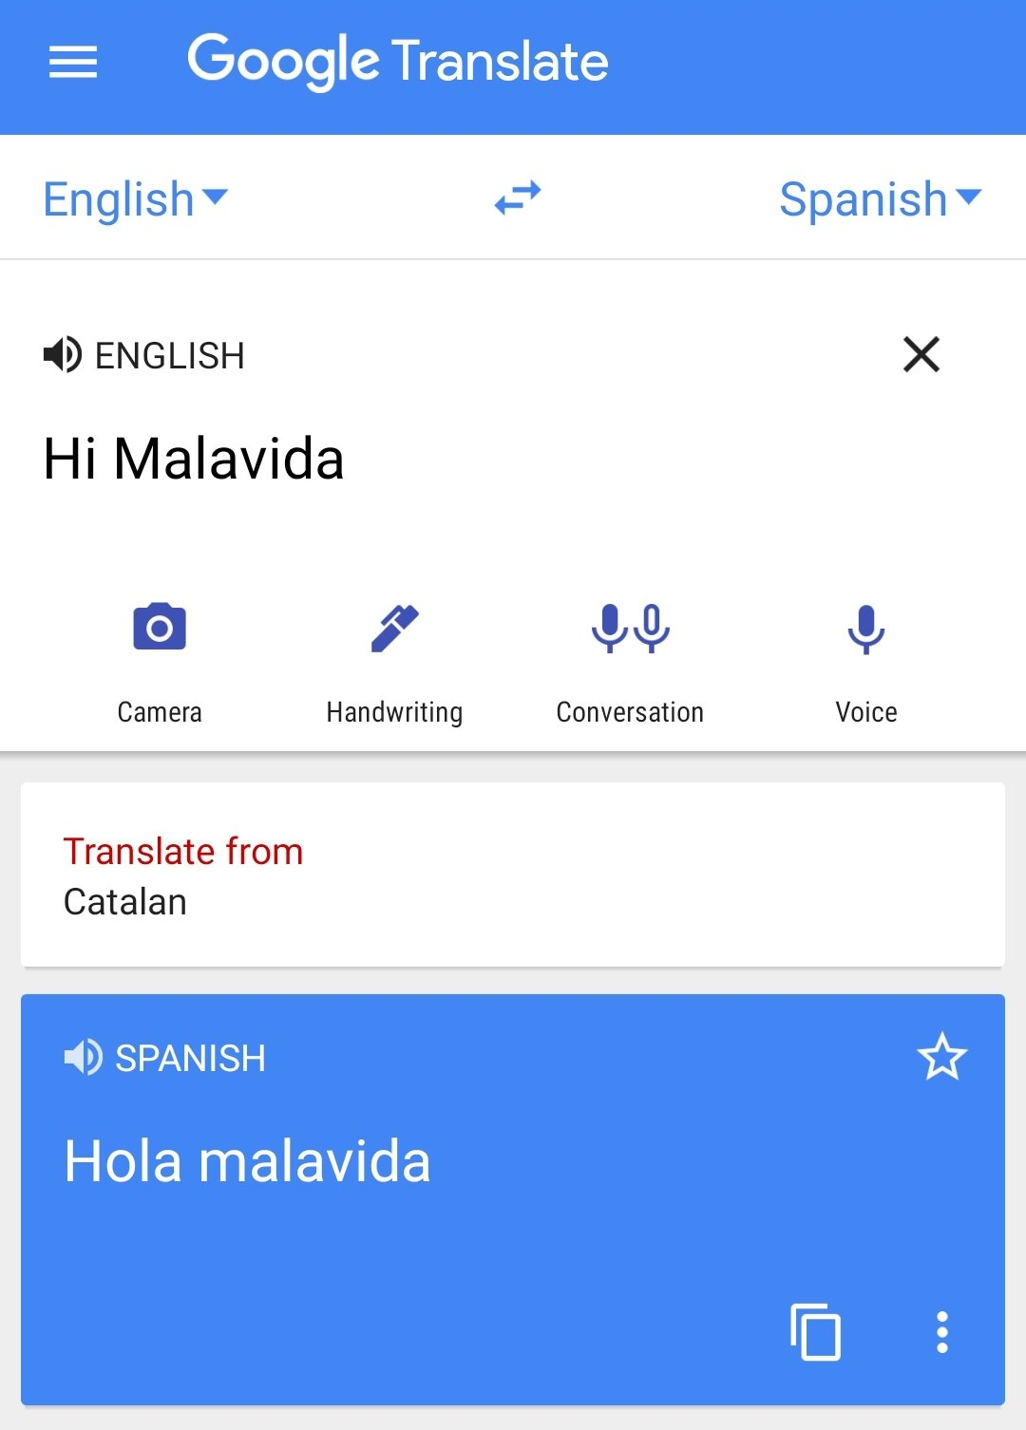
Many-to-many/Sequence-to-sequence models
Definition (many-to-many models):
A many-to-many (or Seq2Seq) model is a machine learning model that:
Takes many inputs (in sequence or not),
And, optionally, a memory vector,
And attempts to produce many outputs.
This is also a very common type of ML problems, which we will investigate more on the coming weeks.

Slide 14
Many-to-many/Sequence-to-sequence models
→ But then, what is the difference between these two diagrams?

Slide 15
Encoder and Decoder models
Definition (encoder and decoder models):
In general, the first part of a Seq2Seq model will focus on analysing the input sequence, eventually producing a final memory vector output after having seen all inputs. This is called an encoder.
Can be done with a RNN of some sort, where the final memory state is called the encoding vector.
E.g. read an English sentence, progressively encoding each word’s meaning, to obtain the entire sentence meaning in a single encoding vector.

Slide 16
Encoder and Decoder models
Definition (encoder and decoder models):
In general, the second part of the model will focus on analysing the produced encoding vector and producing a sequence of some sort as output. This is called a decoder.
Can be done with the same (or another) RNN of some sort, where the first memory state consists of the encoding vector.
E.g. read an encoding vector describing an English sentence and produce an output sequence being the French translation.

Slide 17
Encoder and Decoder models
Encoder model: can be seen as a many-to-one model of some sort, receiving a sequence as input and producing a single encoding vector as output.
Decoder model: does the opposite (kind of), receiving this single encoding vector as input and producing a sequence as output.

Slide 18
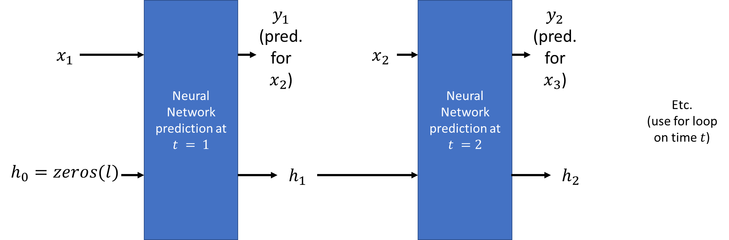

A quick word on autoregressive RNNs
Our previous RNN models looked like this: start with an empty memory vector $h_{0}$, predict $y_{t}$ and update memory vector $h_{t}$using a new observation $x_{t}$ as input on each time step.

Slide 19

A quick word on autoregressive RNNs
Important: our RNNs models would not be using our prediction $y_{t}$ as the new observation for the next step $x_{t+1}$!

Slide 20
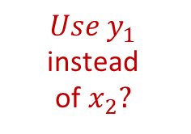
A quick word on autoregressive RNNs
But what if we did?
$$Use y_{1}$$
instead of$x_{2}?$

Slide 21
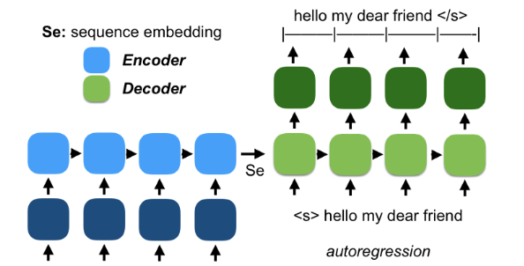
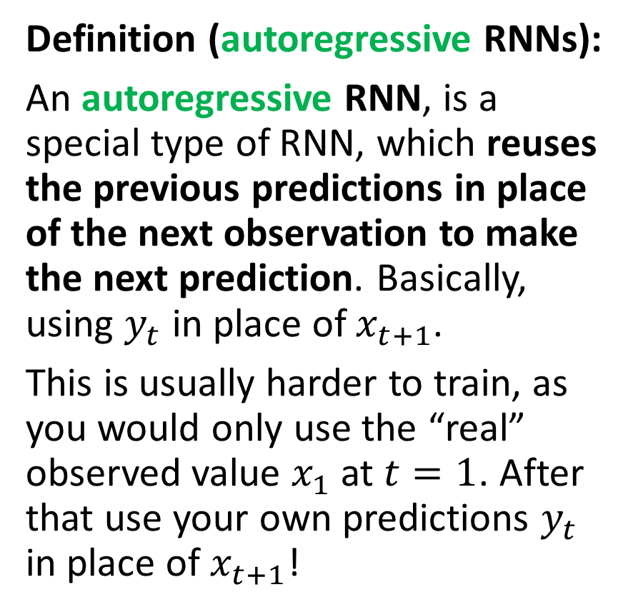
A quick word on autoregressive RNNs
Definition (autoregressive RNNs):
An autoregressive RNN, is a special type of RNN, which reuses the previous predictions in place of the next observation to make the next prediction. Basically, using $y_{t}$ in place of $x_{t+1}$.
This is usually harder to train, as you would only use the “real” observed value $x_{1}$ at $t=1$. After that use your own predictions $y_{t}$ in place of $x_{t+1}$!
Bonjour Mon Cher Ami

Slide 22
A quick word on autoregressive RNNs
Typically, we love to use these autoregressive models in Natural Language Processing, for instance when it comes to generating output sequences.
E.g. generate an English sentence for a given encoding vector describing the meaning of a French sentence.
Bonjour Mon Cher Ami

Slide 23
A quick word on autoregressive RNNs
Encoder reads the French sentence and produces a sequence embedding/encoding vector Se as the final memory vector.
Bonjour Mon Cher Ami

Slide 24
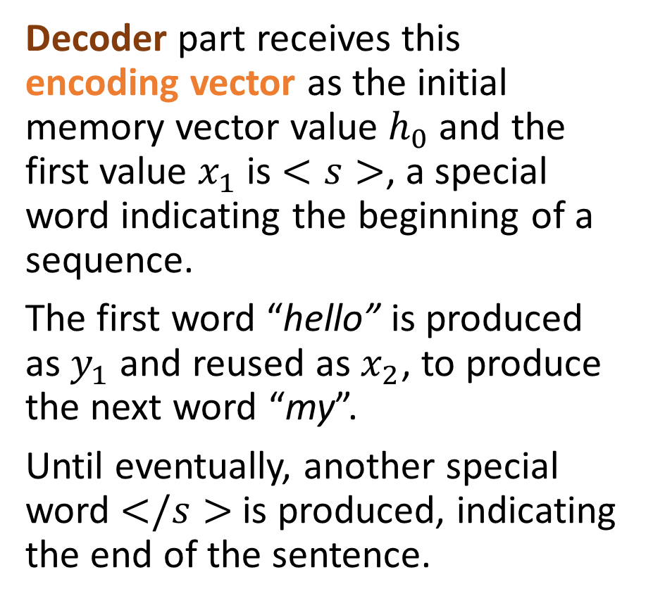
A quick word on autoregressive RNNs
Decoder part receives this encoding vector as the initial memory vector value $h_{0}$ and the first value $x_{1}$ is $<s>$, a special word indicating the beginning of a sequence.
The first word “hello” is produced as $y_{1}$ and reused as $x_{2}$, to produce the next word “my”.
Until eventually, another special word $</s>$is produced, indicating the end of the sentence.
Bonjour Mon Cher Ami

Slide 25
A quick word on autoregressive RNNs
Typically, ChatGPT is a Seq2Seq model using autoregressive RNNs!
Takes a sequence of words as input (the user question) and encodes it,
And uses a decoder architecture of some sort to reconstructs an answer, a sentence, one word after the other!

Slide 26
A quick word on autoregressive RNNs
Typically, ChatGPT is a Seq2Seq model using autoregressive RNNs!
Takes a sequence of words as input (the user question) and encodes it,
And uses a decoder architecture of some sort to reconstructs an answer, a sentence, one word after the other!

Slide 27
A quick word on autoregressive RNNs
Typically, ChatGPT is a Seq2Seq model using autoregressive RNNs!
Takes a sequence of words as input (the user question) and encodes it,
And uses a decoder architecture of some sort to reconstructs an answer, a sentence, one word after the other!
We will learn more about these during Weeks 8 and 12!
(And during the NLP specialty course on Term 7!)

Slide 28
Conclusion (Week 6)
Time series datasets
Deep learning models with history
History length tradeoffs
Implementing memory in Deep Learning models
Our first vanilla Recurrent Neural Network with memory
The vanishing gradient problem in RNNs
The LSTM model
The GRU model
One/Many-to-one/many models
Seq2Seq models
Encoder and Decoder architectures
Autoregressive RNNs
(More on these during W8!)

Slide 29
Learn more about these topics
Out of class, supporting papers, for those of you who are curious.
[Hochreiter1997] S. Hochreiter and J. Schmidhuber “Long short-term memory”, 1997.
[Gers2013] F. A. Gers, J. Schmidhuber, F. Cummin, “Learning to forget: Continual prediction with LSTM”, 2013.
[Cho2014] K. Cho, B. van Merrienboer, C. Gulcehre, D. Bahdanau, F. Bougares, H. Schwenk, and Y. Bengio, “Learning Phrase Representations using RNN Encoder-Decoder for Statistical Machine Translation”, 2014.

Slide 30
Learn more about these topics
Tracking important names (Track their works and follow them on Scholar, Twitter, or whatever works for you!)
Kyunghyun Cho: Professor at New York University. https://scholar.google.co.uk/citations?user=0RAmmIAAAAAJ&hl=en https://kyunghyuncho.me/
Dzmitry Bahdanau: Research Scientist at Element AI and Adjunct Professor at McGill University. https://scholar.google.de/citations?user=Nq0dVMcAAAAJ&hl=en https://rizar.github.io/

Slide 31
Learn more about these topics
Tracking important names (Track their works and follow them on Scholar, Twitter, or whatever works for you!)
Jürgen Schmidhuber: Professor at the University of Lugano in Switzerland. https://scholar.google.com/citations?user=gLnCTgIAAAAJ&hl=fr https://people.idsia.ch/~juergen/
Sepp Hochreiter: Professor at the Johannes Kepler University of Linz in Austria. https://scholar.google.at/citations?user=tvUH3WMAAAAJ&hl=en https://www.iarai.ac.at/people/sepphochreiter/

Slide 32
Learn more about these topics
Some extra (easy) reading and videos for those of you who are curious.
[LesleyEdu] “How Memories Are Made: Stages of Memory Formation”, explains in simple terms how the human brain processes information and generates memory. https://lesley.edu/article/stages-of-memory
[Medium] “GPT-3, RNNs and All That: A Deep Dive into Language Modelling”, explains how Large Language Models (such as ChatGPT) work using autoregressive RNNs. Note: the transformer part will be covered on Week 8! https://towardsdatascience.com/gpt-3-rnns-and-all-that-deep-dive-into-language-modelling-7f67658ba0d5

